Slide 1
Intrusion detection in real time Network Log Data (ELK as SIEM)
MSDS18015 Nabeel Raza
MSDS18061 Muhammad Faizan
MSDS18073 Muhammad Nawaz Masood
MSCS17004 Muhammad Bilal Javed
MSCS17053 Asad Manzoor

Slide 2
Problem Statement
Implementing Elastic Stack as a SIEM (Security Information and Event Management) application.

Slide 3
SIEM
“A central log repository that enriches logs and assists threat detection.”
Components:
Log Sources
Log Aggregator
Log Storage and Indexing
Search and Visualization Engine

Slide 4
Elastic Stack
• Open source, real-time search and analytics engine
• Made up of 4 pieces: collection, ingestion, storage, and visualization

Slide 5
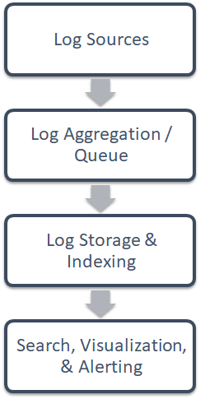



Implementing Elastic Stack as a SIEM

Slide 6
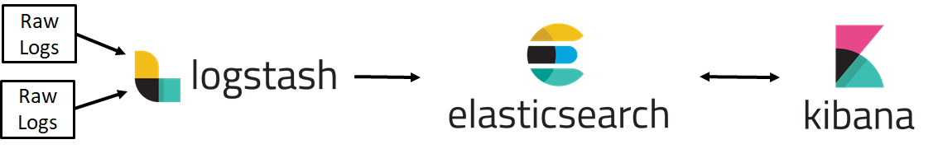
ELK Pipe Line
Log Ingestion & Parsing Log Storage Search & Visualization

Slide 7
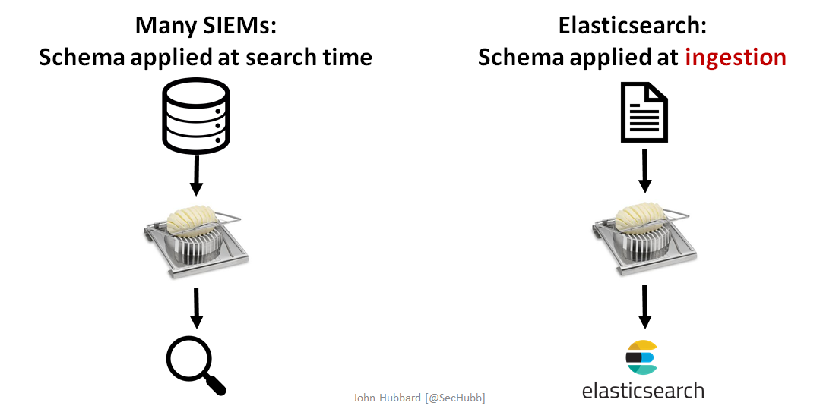
SIEM vs Elasticsearch

Slide 8
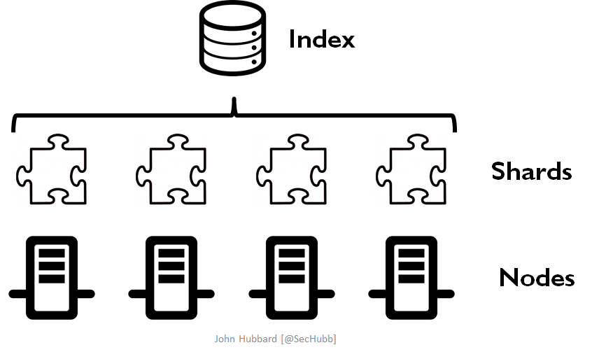
Distributed Storage

Slide 9
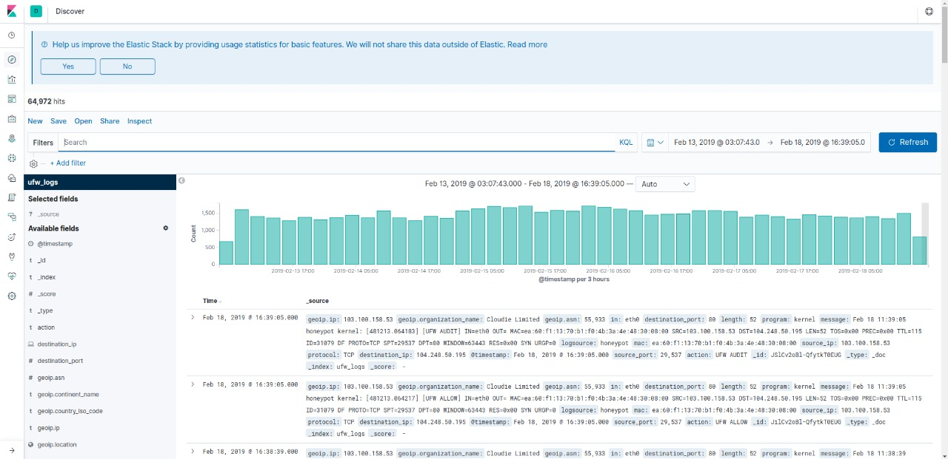
Logs Dataset

Slide 10
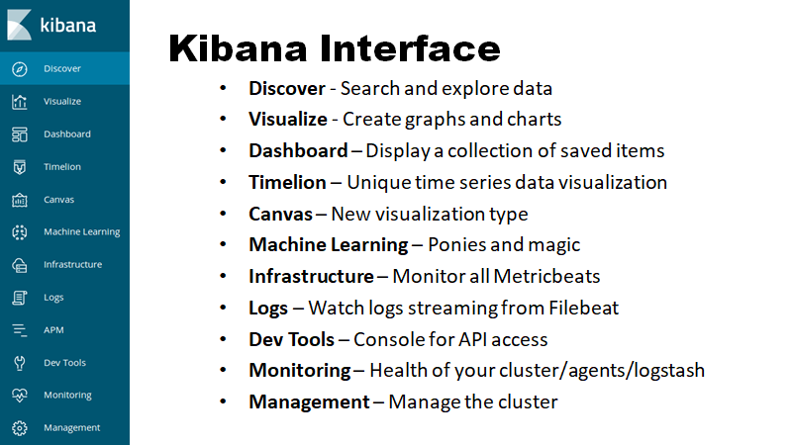

Slide 11
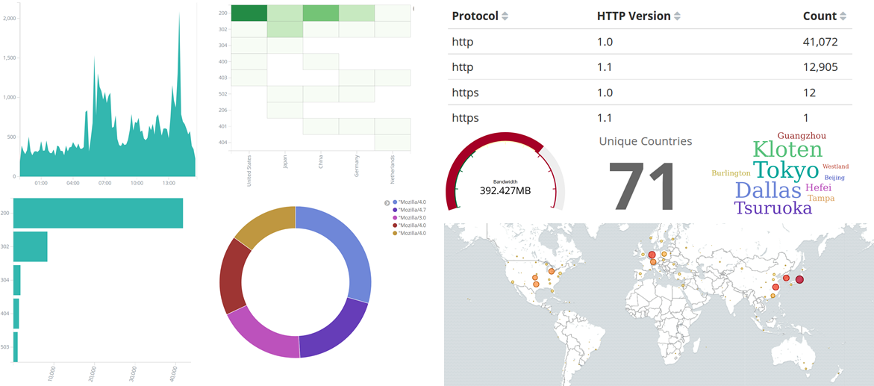
Visualization types

Slide 12
Demo

